Slide 1


Benjamin Müller
16.12.2025

Slide 2

Outline
Executive Summary
Introduction
Methodology
Results
Conclusion
Appendix

Slide 3
Executive Summary
Summary of methodologies
SpaceX Data Collection using SpaceX Api
SpaceX Data Collection using Web Scraping
SpaceX Data Wrangling
SpaceX Exploratory Data Analysis using SQL
SpaceX Exploratory Data Analysis with Python Pandas and Matplotlib
SpaceX Launch Site Analysis with Folium and Plotly
SpaceX Machine Learning Landing Prediction
Summary of all results
Exploratory Data Analysis Results
Interactive Visual Analytics and Dashboards
Predictive Analysis

Slide 4
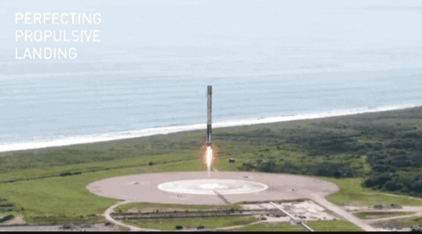
Introduction
Project background and context
SpaceX advertises Falcon 9 rocket launches on its website with a cost of 62 million dollars; other providers cost upward of 165 million dollars each, much of the savings is because SpaceX can reuse the first stage. Therefore if we can determine if the first stage will land, we can determine the cost of a launch. This information can be used if an alternate company wants to bid against SpaceX for a rocket launch
Problems you want to find answers
In this capstone, we will predict if the Falcon 9 first stage will land successfully using data from Falcon 9 rocket launches advertised on its website.

Slide 5

Section 1

Slide 6
Methodology
Executive Summary
Data collection methodology:
SpaceX API, Web Scraping Wikipedia Page
Perform data wrangling
Check Data, clean Data, add Features
Perform exploratory data analysis (EDA) using visualization and SQL
Perform interactive visual analytics using Folium and Plotly Dash
Perform predictive analysis using classification models
How to build, tune, evaluate classification models

Slide 7
Data Collection
The Data was first collected using the SpaceX API (a RESTful API) by making a request. The Data was extracted by using a series of pre defined helper functions.
Finally to make the requested JSON results more consistent, the SpaceX launch data was requested and parsed using the GET request and then decoded the response content as a Json result which was then converted into a Pandas data frame.
The Data was also collected by using web scraping of the Wikipedia paged „List of Falcon 9 and Falcon Heavy launches“ using Beautiful soup. The launch records are stored in an HTML table. The Data was Extracted from the HTML table, parsed and converted into a Pandas dataframe.

Slide 8
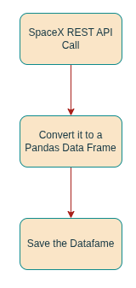
Data Collection – SpaceX API
The Data was pulled from the SpaceX API, using the GET request, then, the request was extracted with the helper functions and then stored in an Pandas Data Frame
See on Github https://github.com/bmueller4/SpaceX-Falcon-9-Success-Landing-Prediction/blob/main/1. SpaceX Data Collection API.ipynb

Slide 9
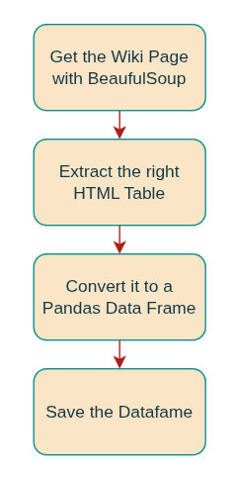
Data Collection - Scraping
The Data was collected by web Scaping using BeautifulSoup from the HTML Table on the Wikipedia Page
See on Github https://github.com/bmueller4/SpaceX-Falcon-9-Success-Landing-Prediction/blob/main/2.%20Web%20scraping%20Falcon%209%20and%20Falcon%20Heavy%20Launches%20Records%20from%20Wikipedia.ipynb

Slide 10
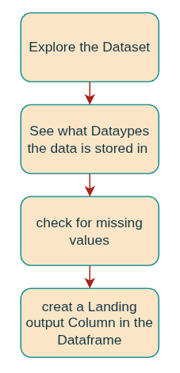
Data Wrangling
First the Dataset was explored to see what data is stored in it and which Datatypes are used.
Then I checked the Dataframe for missing Values
Then a class for the Landing outcome was created 0 for no landing and 1 for landing and stored in the Dataframe
See on Github
https://github.com/bmueller4/SpaceX-Falcon-9-Success-Landing-Prediction/blob/main/2.%20Web%20scraping%20Falcon%209%20and%20Falcon%20Heavy%20Launches%20Records%20from%20Wikipedia.ipynb

Slide 11
EDA with Data Visualization
Performed data Analysis and Feature Engineering using Pandas and Matplotlib.i.e.
• Used scatter plots to visualize the relationship between 2 Features.#
Flight Number and Launch Site, Payload and Launch Site, FlightNumber and Orbit type, Payload and Orbit type
Used Bar Plot to visualize the relationship between different Features to another Feature.
success rate of each orbit type
Used Line Plot to visualize a trend.
Yearly Succes Launch Trend
See on Git
https://github.com/bmueller4/SpaceX-Falcon-9-Success-Landing-Prediction/blob/main/5. Exploring and Preparing Data.ipynb

Slide 12
EDA with SQL
The following SQL queries were performed for EDA
Display unique names from Launch Sites
Display 5 records where launch sites begin with the string 'CCA'
Display the total payload mass carried by boosters launched by NASA (CRS)
Display average payload mass carried by booster version F9 v1.1
List the date when the first successful landing outcome in ground pad was achieved
List the names of the boosters which have success in drone ship and have payload mass greater than 4000 but less than 6000
List the total number of successful and failure mission outcomes
List all the booster_versions that have carried the maximum payload mass, using a subquery with a suitable aggregate function.
List the records which will display the month names, failure landing_outcomes in drone ship ,booster versions, launch_site for the months in year 2015.
Rank the count of landing outcomes (such as Failure (drone ship) or Success (ground pad)) between the date 2010-06-04 and 2017-03-20, in descending order.
See on Github
https://github.com/bmueller4/SpaceX-Falcon-9-Success-Landing-Prediction/blob/main/4. SQL Notebook for Peer Assignment.ipynb

Slide 13
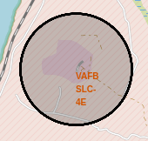
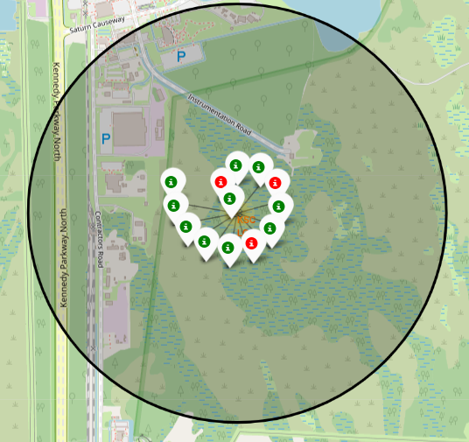
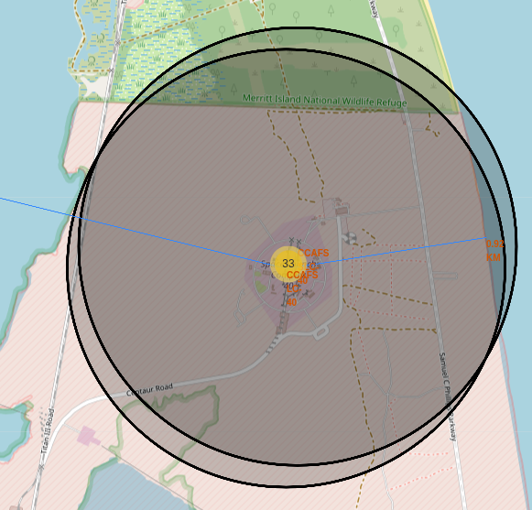
Build an Interactive Map with Folium
Created folium map to marked all the launch sites with circles to see where the launch sites are located and added markers to show there names
Marked the failed and successfull launches with an marker cluster to visualise them
Calculated and printed the distance to the nearest coastline, railways and higways, citys
See on Github
https://github.com/bmueller4/SpaceX-Falcon-9-Success-Landing-Prediction/blob/main/6. Interactive Visual Analytics with Folium.ipynb

Slide 14
Build a Dashboard with Plotly Dash
Built an interactive dashboard application with plotly dash:
Added a Launch Site Drop-down Input Component to analyze every launch site by its own
Added a callback function to show success rates on a pie-chart based on selected site dropdown
Added range slider to select between different payload ranges
Added a callback function to render the success-payload-scatter-chart scatter plot
See on Github
https://github.com/bmueller4/SpaceX-Falcon-9-Success-Landing-Prediction/blob/main/6. Interactive Visual Analytics with Folium.ipynb

Slide 15
Predictive Analysis (Classification)
Loaded the Data into Pandas Dataframe X
Created the outcome variable Y from the column Class and converted it to an np array
Scale the input data X with the Standart Scaler and transform it
Split the Data into training and testing sets with train_test_split()
Train different models with an Grid Search and get the scores
Logistic Regression
Support Vector Machine
Decision Tree
K-nearest Neighbors
See on Github
http://localhost:8888/lab/tree/Downloads/Space X -Falcon/8. SpaceX_Machine Learning Prediction.ipynb

Slide 16
Results
Exploratory data analysis results
We can see the incresing sucess rate over the time from 2010 with 0% to 2020 with around 80%
The highest Success rate is on orbit ES-L1, GEO, HEO with a stunning 100% sucess rate
You can observe that in the LEO orbit, success seems to be related to the number of flights. Conversely, in the GTO orbit, there appears to be no relationship between flight number and success.
Predictive analysis results
We can predict an landing result with an accuracity of 83.333%

Slide 17
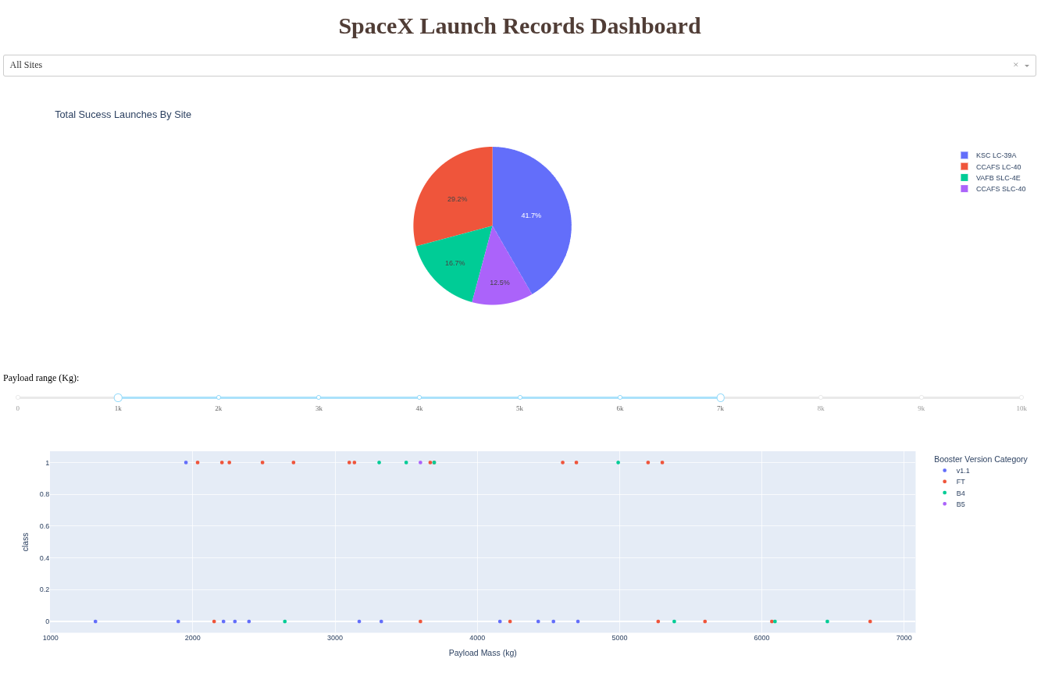
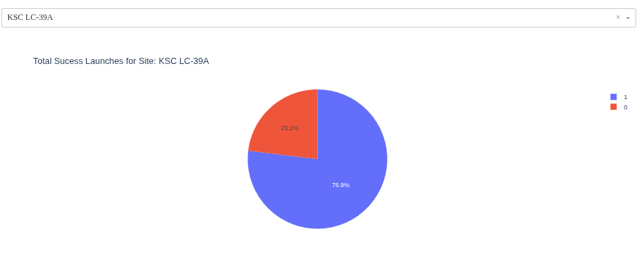
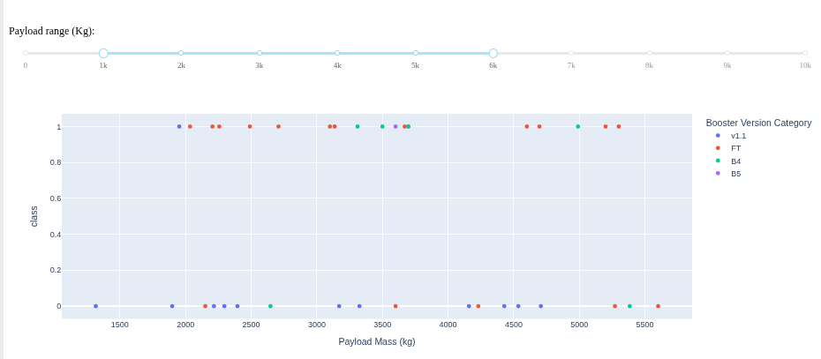
Interactive Analytic Dashboard

Slide 18

Section 2

Slide 19
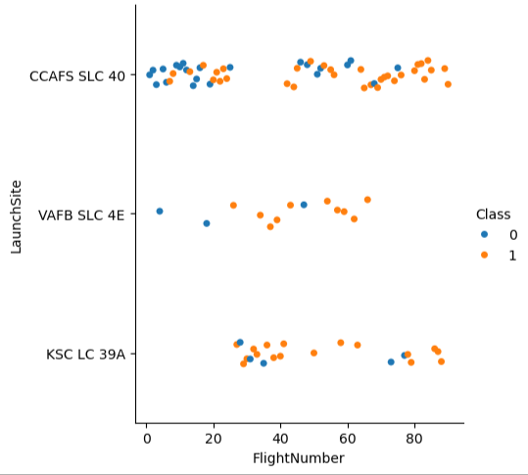
Flight Number vs. Launch Site
Comparision between the flight number an lauch sites
The most flights are from CCAFS SLC 40
The least flights are from VAFB SLC 4E
The succes rate increases with the Flightnumbers

Slide 20
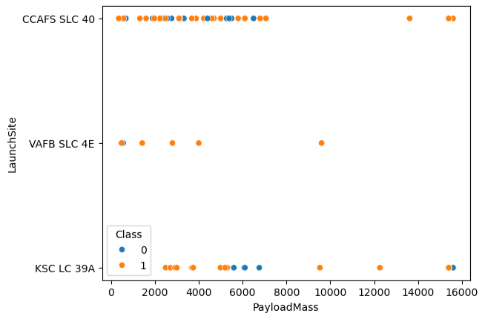
Payload vs. Launch Site
VAFB-SLC launch site has no rockets launched heavier than Payload mass 10000

Slide 21
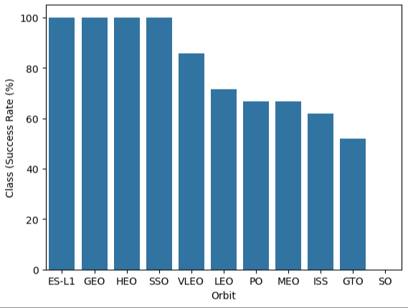
Success Rate vs. Orbit Type
The highest Success rate is on orbit ES-L1, GEO, HEO with a stunning 100% sucess rate
SO has the least success rate with 0%

Slide 22
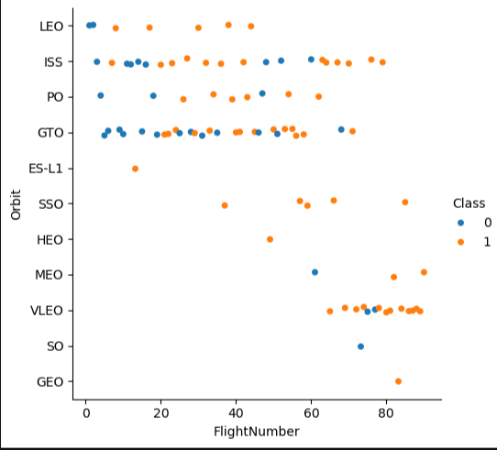
Flight Number vs. Orbit Type
You can observe that in the LEO orbit, success seems to be related to the number of flights. Conversely, in the GTO orbit, there appears to be no relationship between flight number and success.

Slide 23
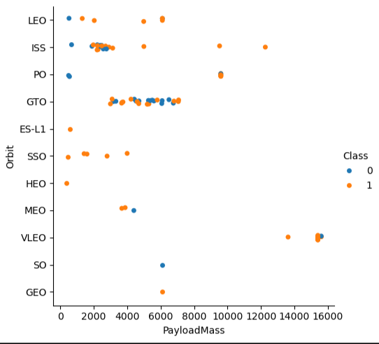
Payload vs. Orbit Type
With heavy payloads the successful landing or positive landing rate are more for Polar,LEO and ISS.
However, for GTO, it's difficult to distinguish between successful and unsuccessful landings as both outcomes are present.

Slide 24
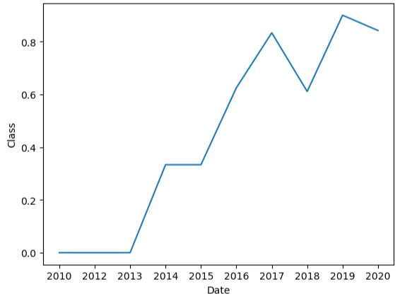
Launch Success Yearly Trend
We can see the incresing sucess rate over the time from 2010 with 0% to 2020 with around 80%

Slide 25
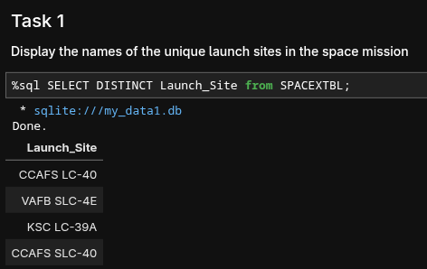
All Launch Site Names
%sql SELECT DISTINCT Launch_Site from SPACEXTBL;
‚SELECT DISTINCT‘ returns only unique launch sites from the ‚Launch_Site‘ coloumn ot the ‚SPACEXTBL‘ Table

Slide 26
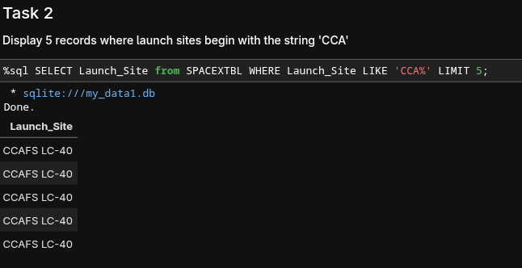
Launch Site Names Begin with 'CCA'
%sql SELECT Launch_Site from SPACEXTBL WHERE Launch_Site LIKE 'CCA%' LIMIT 5;
‚LIKE‘ command searches strings with Wilcard ‚%‘ in ‚WHERE‘ clause to select and display a table of all records that begin with ‚CCA‘

Slide 27
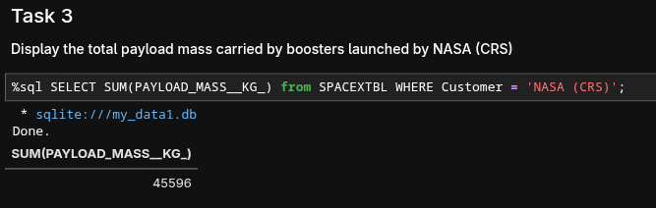
Total Payload Mass
%sql SELECT SUM(PAYLOAD_MASS__KG_) from SPACEXTBL WHERE Customer = 'NASA (CRS)';
‚SUM()‘ function gives you the total sum of ‚PAYLOAD_MASS__KG_‘
WHERE Customer = 'NASA (CRS) gives you only entries when Customer is 'NASA (CRS)

Slide 28
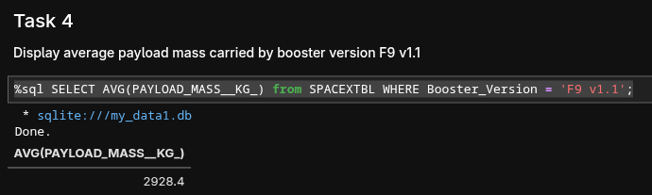
Average Payload Mass by F9 v1.1
%sql SELECT AVG(PAYLOAD_MASS__KG_) from SPACEXTBL WHERE Booster_Version = 'F9 v1.1';
‚AVG()‘ function gives you the average of ‚PAYLOAD_MASS__KG_‘
Booster_Version = 'F9 v1.1' gives you only entries when Booster is 'F9 v1.1'

Slide 29
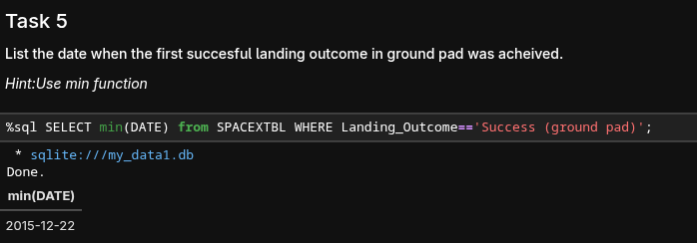
First Successful Ground Landing Date
%sql SELECT MIN(DATE) from SPACEXTBL WHERE Landing_Outcome=='Success (ground pad)';
‚MIN()‘ fuction gives you the minimum (oldest) date, when Landing_Outcome is Success (ground pad)

Slide 30
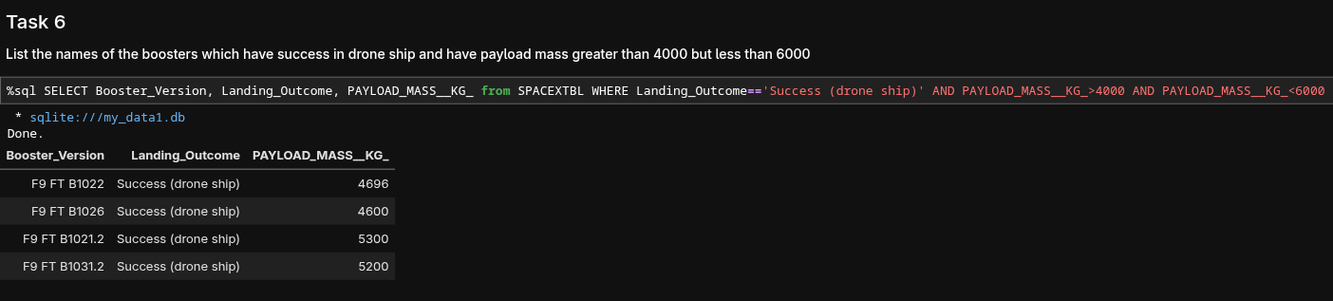
Successful Drone Ship Landing with Payload between 4000 and 6000
%sql SELECT Booster_Version, Landing_Outcome, PAYLOAD_MASS__KG_ from SPACEXTBL WHERE Landing_Outcome=='Success (drone ship)' AND PAYLOAD_MASS__KG_>4000 AND PAYLOAD_MASS__KG_<6000
‚AND‘ Statement has to fulfill both arguments
Used operators ‚<‘ and ‚>‘ to list booser beetween 4000 and 6000 kg Payload

Slide 31
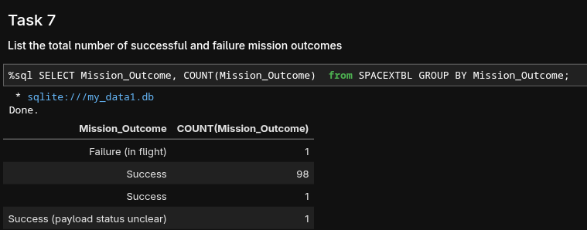
Total Number of Successful and Failure Mission Outcomes
%sql SELECT Mission_Outcome, COUNT(Mission_Outcome) from SPACEXTBL GROUP BY Mission_Outcome;
‚COUNT()‘ function with ‚GROUP BY()‘ function returns the total number of mission outcomes

Slide 32
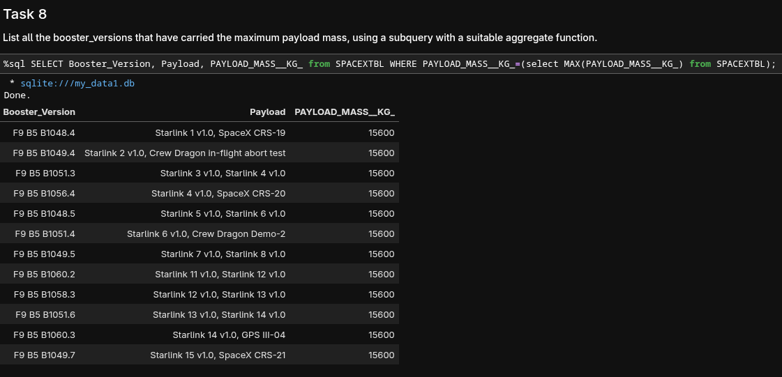
Boosters Carried Maximum Payload
%sql SELECT Booster_Version, Payload, PAYLOAD_MASS__KG_ from SPACEXTBL WHERE PAYLOAD_MASS__KG_=(select MAX(PAYLOAD_MASS__KG_) from SPACEXTBL);
Using a Subquerry to return and pass the Max payload and used it list all the boosters that have carried the Max payload of 15600kgs

Slide 33
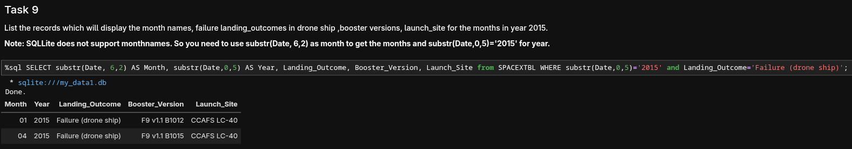
2015 Launch Records
%sql SELECT substr(Date, 6,2) AS Month, substr(Date,0,5) AS Year, Landing_Outcome, Booster_Version, Launch_Site from SPACEXTBL WHERE substr(Date,0,5)='2015' and Landing_Outcome='Failure (drone ship)';
Used the ‘subsrt()’ in the select statement to get the month and year from the date column where substr(Date,7,4)='2015' for year and Landing_outcome was ‘Failure (drone ship’)
‚AS‘ statement gives a column name

Slide 34
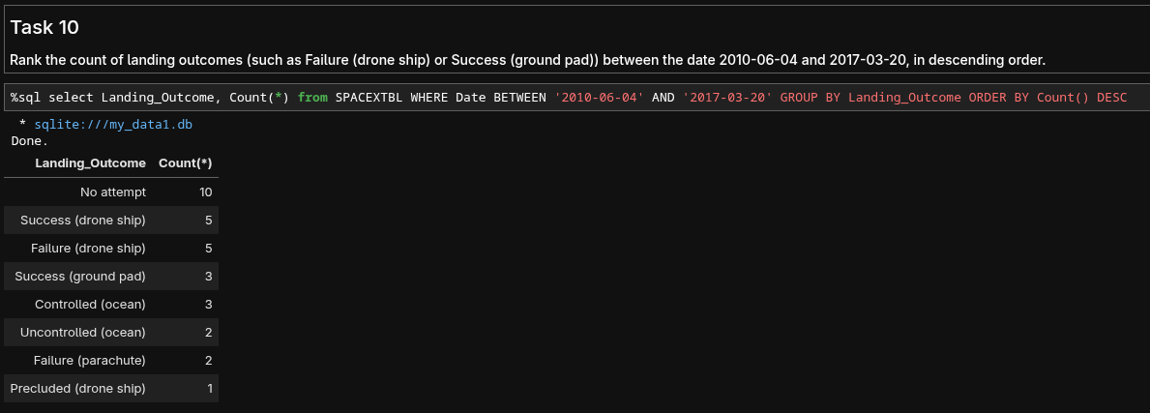
Rank Landing Outcomes Between 2010-06-04 and 2017-03-20
%sql select Landing_Outcome, Count(*) from SPACEXTBL WHERE Date BETWEEN '2010-06-04' AND '2017-03-20' GROUP BY Landing_Outcome ORDER BY Count() DESC
„Count()“ with „GROP BY“ Landing_Outcome gives you the counts
„BETWEEN“ statement gives you the columns between the dates

Slide 35

Section 3

Slide 36
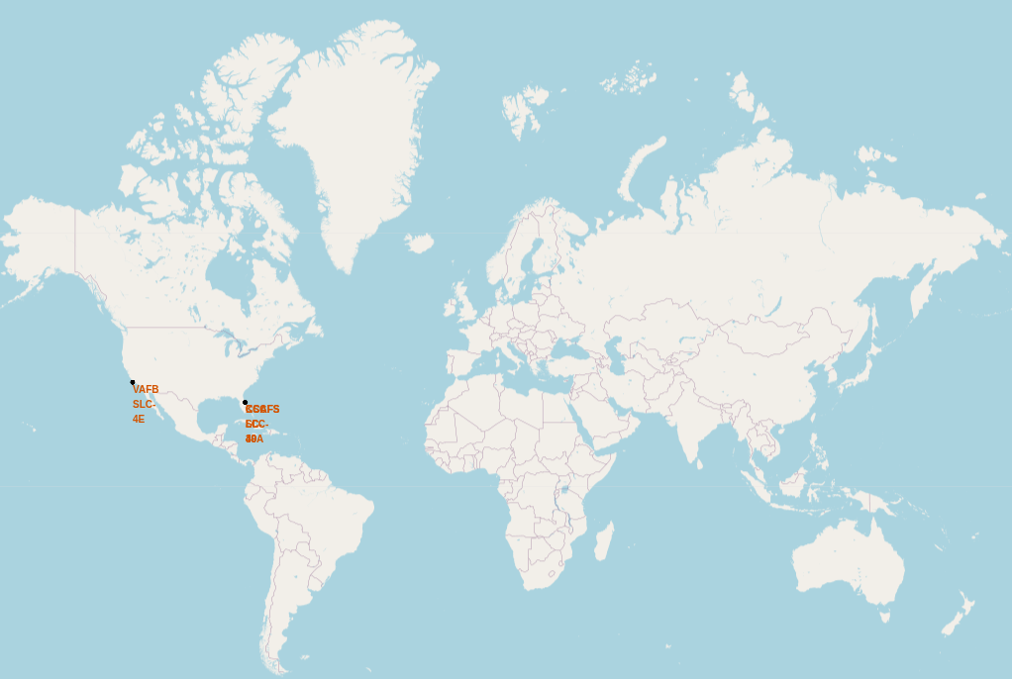
Global Launch Sites
All launch sites are in the US and in an near proximity of the Equator and to the coast

Slide 37
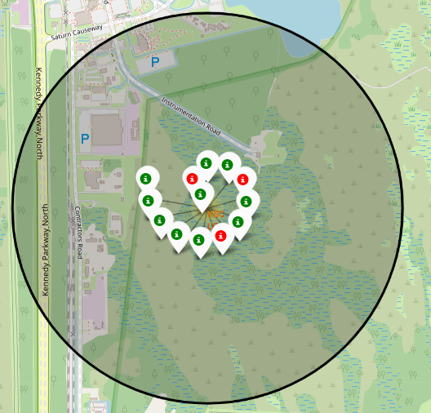
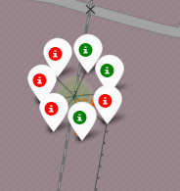
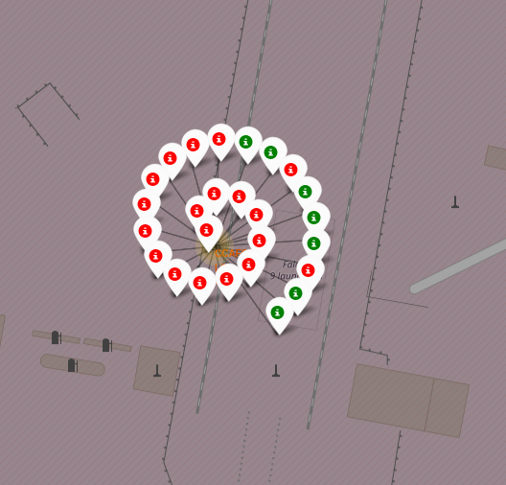
Launch outcomes for ech site on the map (Florida)
KSC LC-39A CCAFS SLC-40 CCAFS LC-40
In the Eastern coast (Florida) Launch site KSC LC-39A has relatively high success rates compared to CCAFS SLC-40 & CCAFS LC-40.

Slide 38
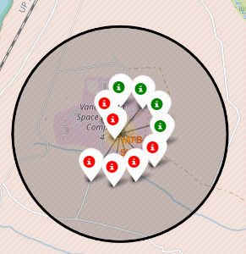
Launch outcomes for ech site on the map (California)
In the West Coast (California) Launch site VAFB SLC-4E has relatively lower success rates 4/10 compared to KSC LC-39A launch site in the Eastern Coast of Glorida.

Slide 39
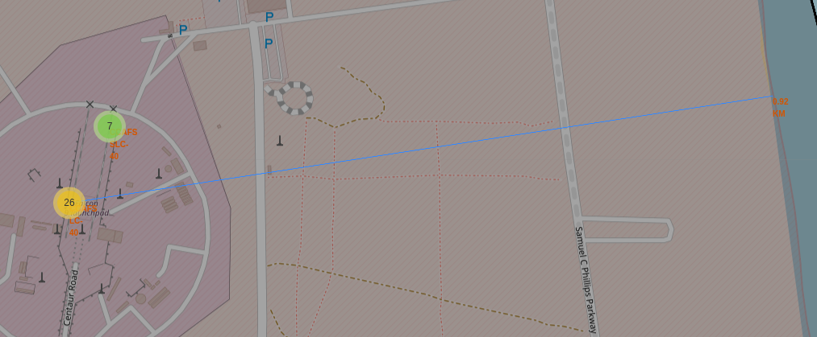
Distance between a launch site to its proximities
The distance between Launch Site CCAFS LC-40 and the coast ist 0.92 km

Slide 40
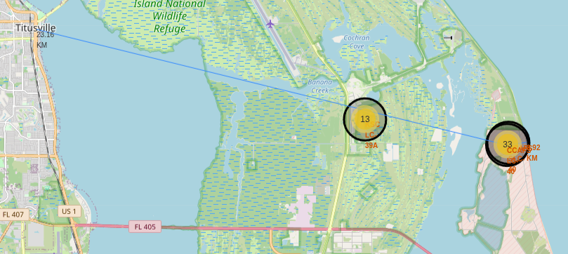
Distance between a launch site to its proximities
The distance between Launch Site CCAFS LC-40 and the City Titusville 23.16 km

Slide 41

Section 4

Slide 42
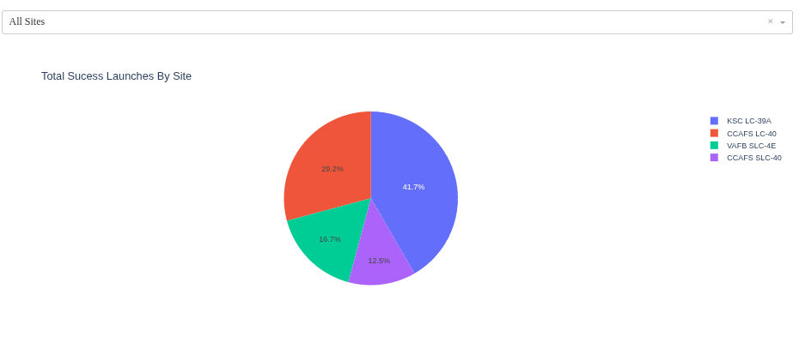
Pie Chart for launch success count for all sites
Launch site KSC LC-39A has the highest launch success rate at 41.7% followed by CCAFS, LC-40 at 29.2%, VAFB SLC-4E at 16.7% and lastly launch site CCAFS SLC-40 with a success rate of 12.5%

Slide 43
Pie Chart for launch site with the highest launch succes ratio
KSC LC-39A has a success rate of 76.9%. Only 23.1% were not succesfull

Slide 44
Payload vs Launch Outcome for all Launch Sides
Booster FT has the best sucess rate for every Payload
Booseter V1.1 has the most failed Launches ofer all Payloads

Slide 45
Payload vs Launch Outcome for all Launch Sides
Booster FT has the best sucess rate for every Payload
Booseter V1.1 has the most failed Launches ofer all Payloads

Slide 46

Section 5

Slide 47
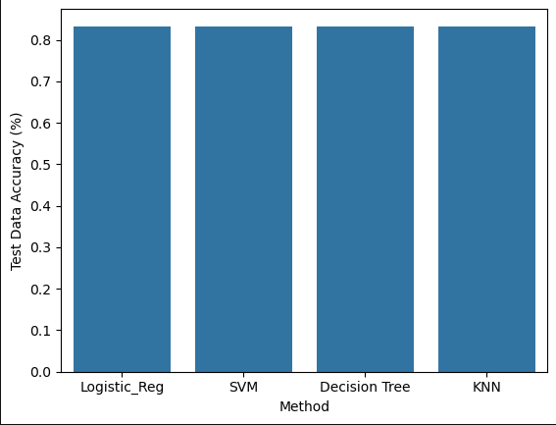
Classification Accuracy
All Models perform equally on the test data
Around 83.33333 % accuracy

Slide 48
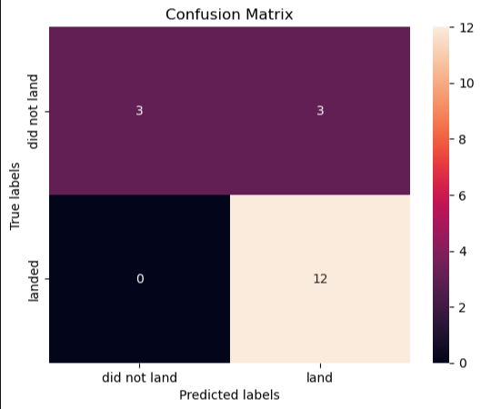
Confusion Matrix
All the 4 classification model had the same confusion matrixes and were able equally distinguish between the different classes. The major problem is false positives for all the models.

Slide 49
Conclusions
With heavy payloads the successful landing or positive landing rate are more for Polar,LEO and ISS.
However for GTO we cannot distinguish this well as both positive landing rate and negative landing(unsuccessful mission) are both
And finally the success rate since 2013 kept increasing till 2020.

Slide 50
Appendix
See on Github
https://github.com/bmueller4/SpaceX-Falcon-9-Success-Landing-Prediction/tree/main

Slide 51


